Slide 1

Installation of exterior panels on the new UAF engineering building
Photo courtesy of UAF Photography

Slide 2
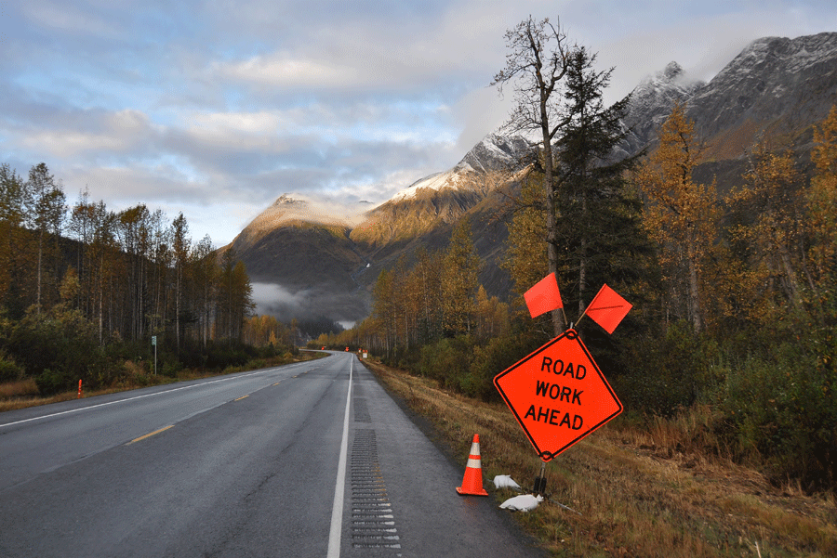


Slide 3
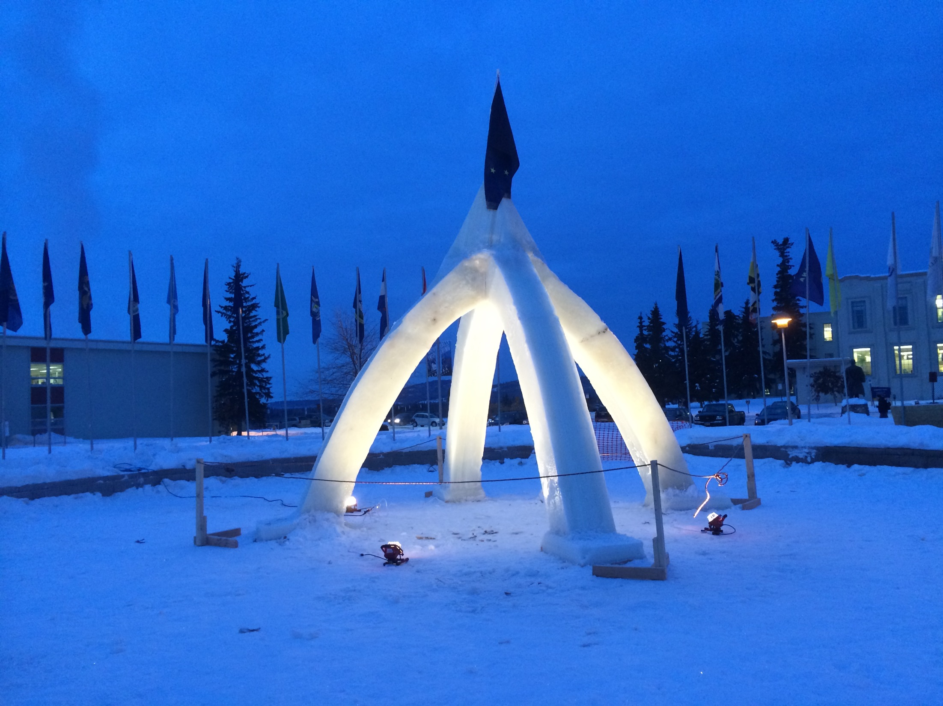
An early morning view of the newly-erected 2015 Ice Arch
Photo courtesy of Kim FIsher

Slide 4
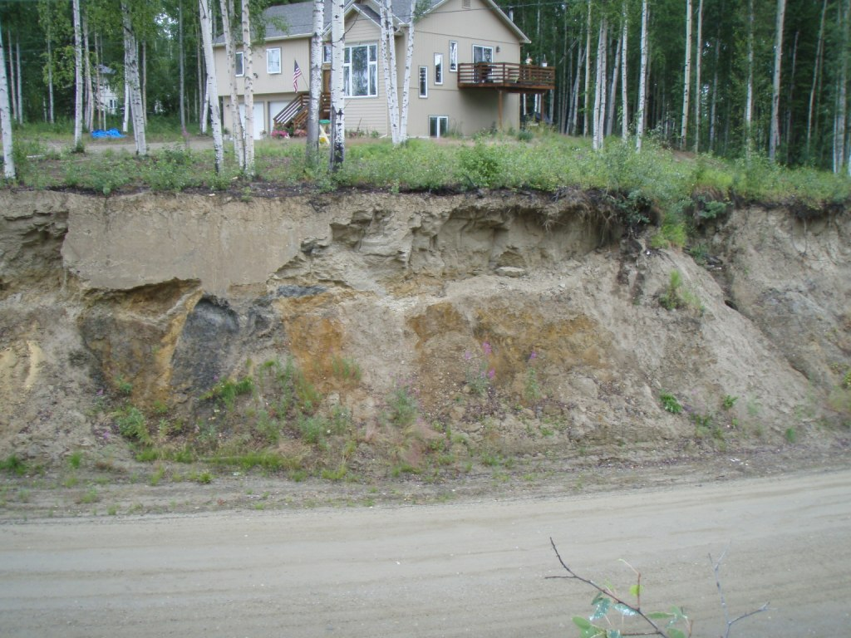

Slide 5

Math Counts Challenge!
A restaurant automatically adds an 18% tip to the bill. If the tip was $9, what was the bill before the tip was added, in dollars?
Answer to follow

Slide 6
Answer: 50 (dollars)

Slide 7



Slide 8
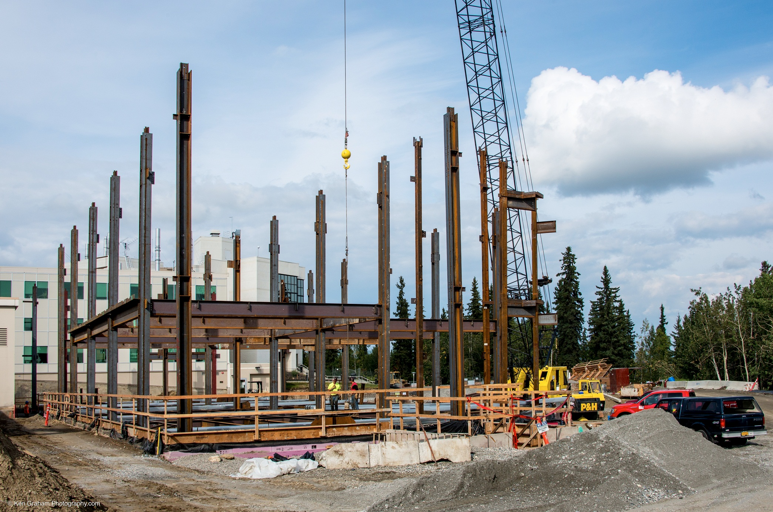


Slide 9
ConocoPhillips has been leading the search for energy in Alaska for more than 50 years. The company is committed to responsibly developing Alaska’s resources, providing economic opportunity for Alaska, operating at the highest safety standards and being good stewards of our communities.

Slide 10
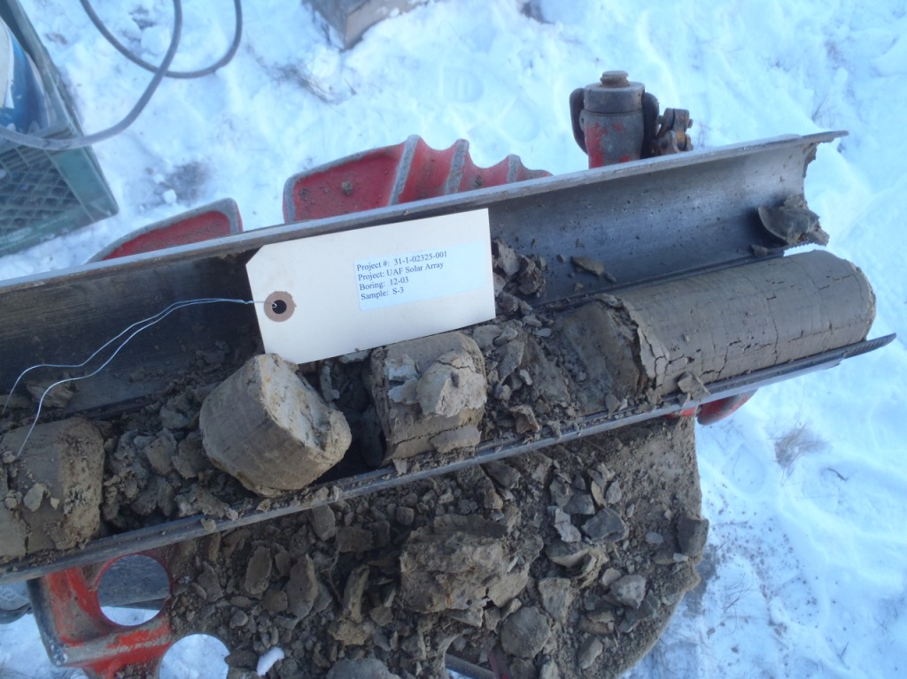

Slide 11


Slide 12
CONGRATULATIONS TO THE 2012 NEWLY REGISTERED P.E.s!
Daniel B. Holmgren, PE
William E. Schnabel, PE
Patricia T. Crisenbery, PE
Elliot C. Wilson, PE
Sarah L. Belway, PE
Donald L. Hopkins, PE
Lee A. Johnson, PE
Patricia R. Bowen, PE
Julie A. Keener, PE
James B. Rutter IV, PE
Bruce T. Dianoski, PE
Margaret M. Darrow, PE
Lance Roberts, PE
Shane W. Gibson, PE
Jason Colquhoun, PE
Timothy J. Diedrich, PE
Troy M. Hicks, PE
Jason L. Webb, PE
J. Leroy Hulsey, PE
John Michael, PE
Alicia S. Mayo, PE
Chris H. Miller, PE
Scott D. Hulac, PE
Jonathan J. Hutchinson, PE
Marcus P. Curley, PE
Rebecca E. Gumbs, PE
Wesley D. Hopwood, PE
Tumen Badarch, PE
Mitchell S. O’Bryant, PE
Carl I. Olson, PE

Slide 13
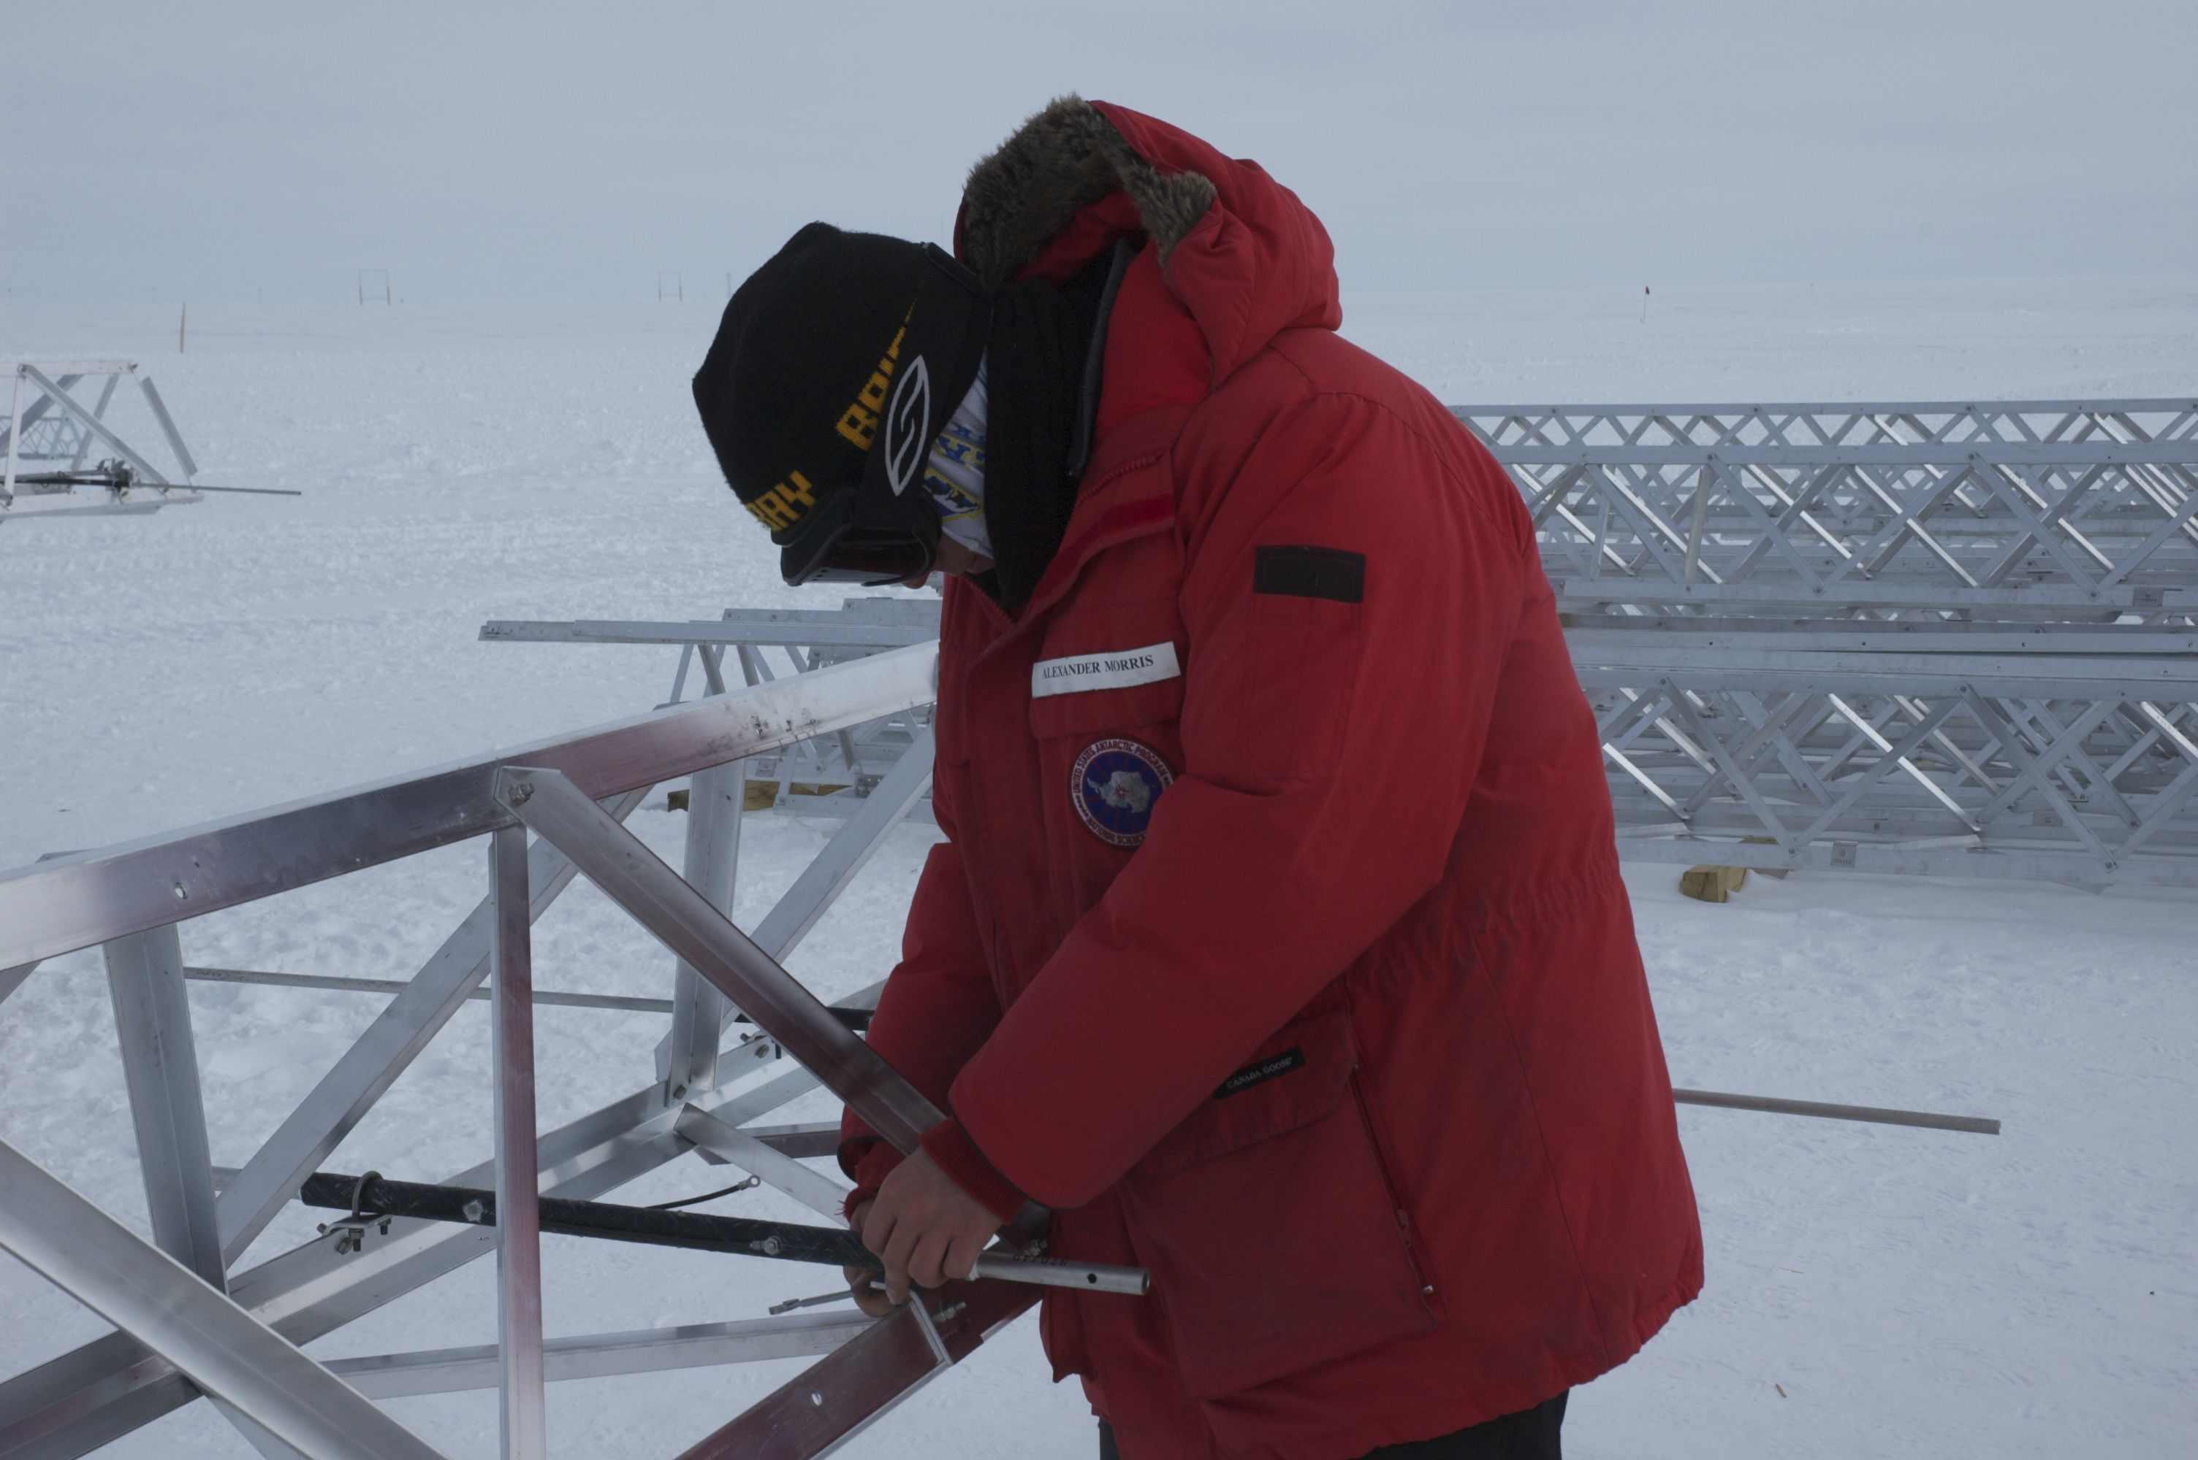
Former UAF Electrical Engineering graduate student Alexander Morris works on building an atmospheric radar in Antarctica
Photo courtesy of UAF Department of Electrical and Computer Engineering

Slide 14
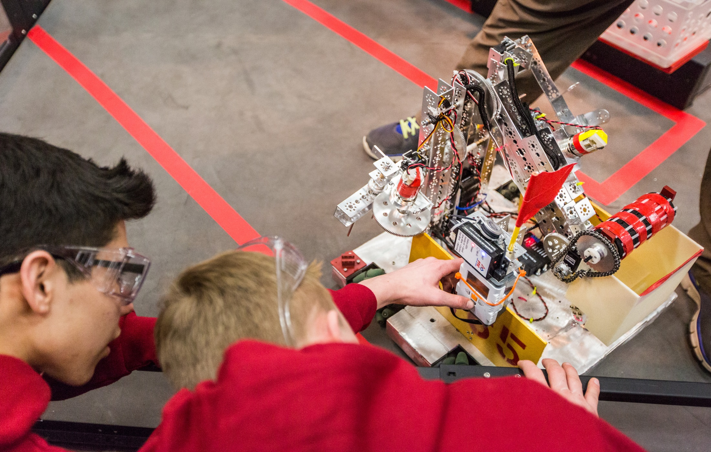
High school students compete in the UAF-sponsored 2014 FTC Robotics State Championships
Photo courtesy of UAF Photography

Slide 15
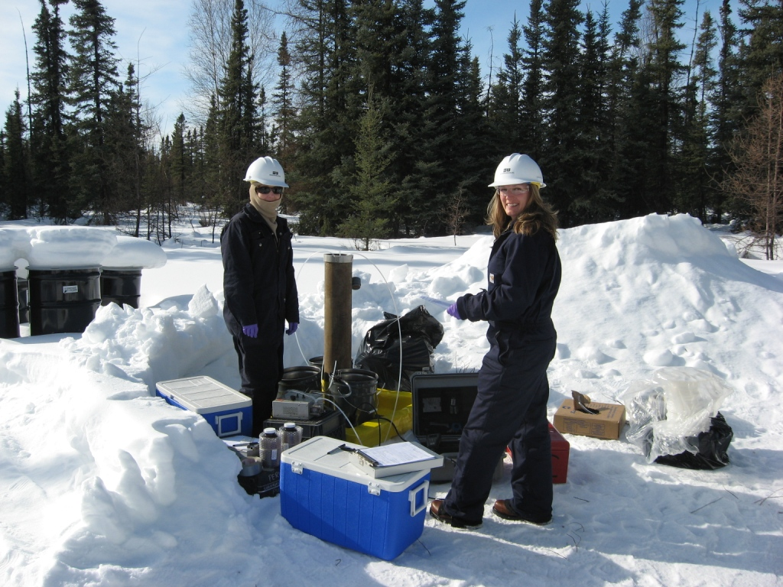

Slide 16
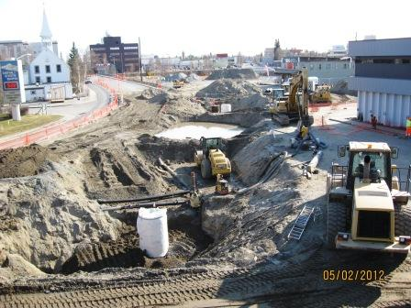


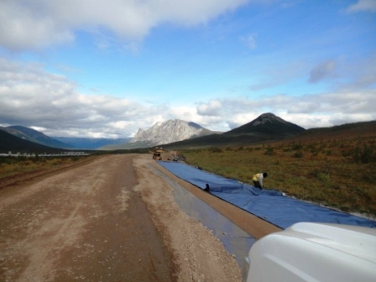
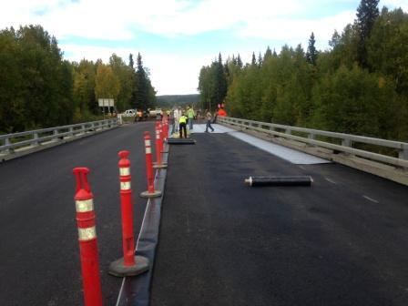
Contractors
• Paving
• Site Development
• Geotextile

Slide 17
Math Counts Challenge!
What is the smallest positive integer a such that is an integer?
1
2
3
a²
Answer to follow

Slide 18
Answer: 6

Slide 19
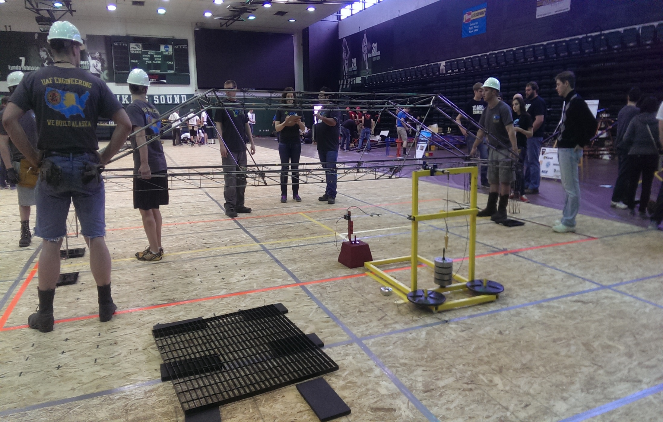
The 2014 UAF Steel Bridge Team competes in a regional competition at Portland State University
Photo courtesy of UAF Department of Civil and Environmental Engineering

Slide 20

THANK YOU TO OUR
GENEROUS SPONSORS

Slide 21
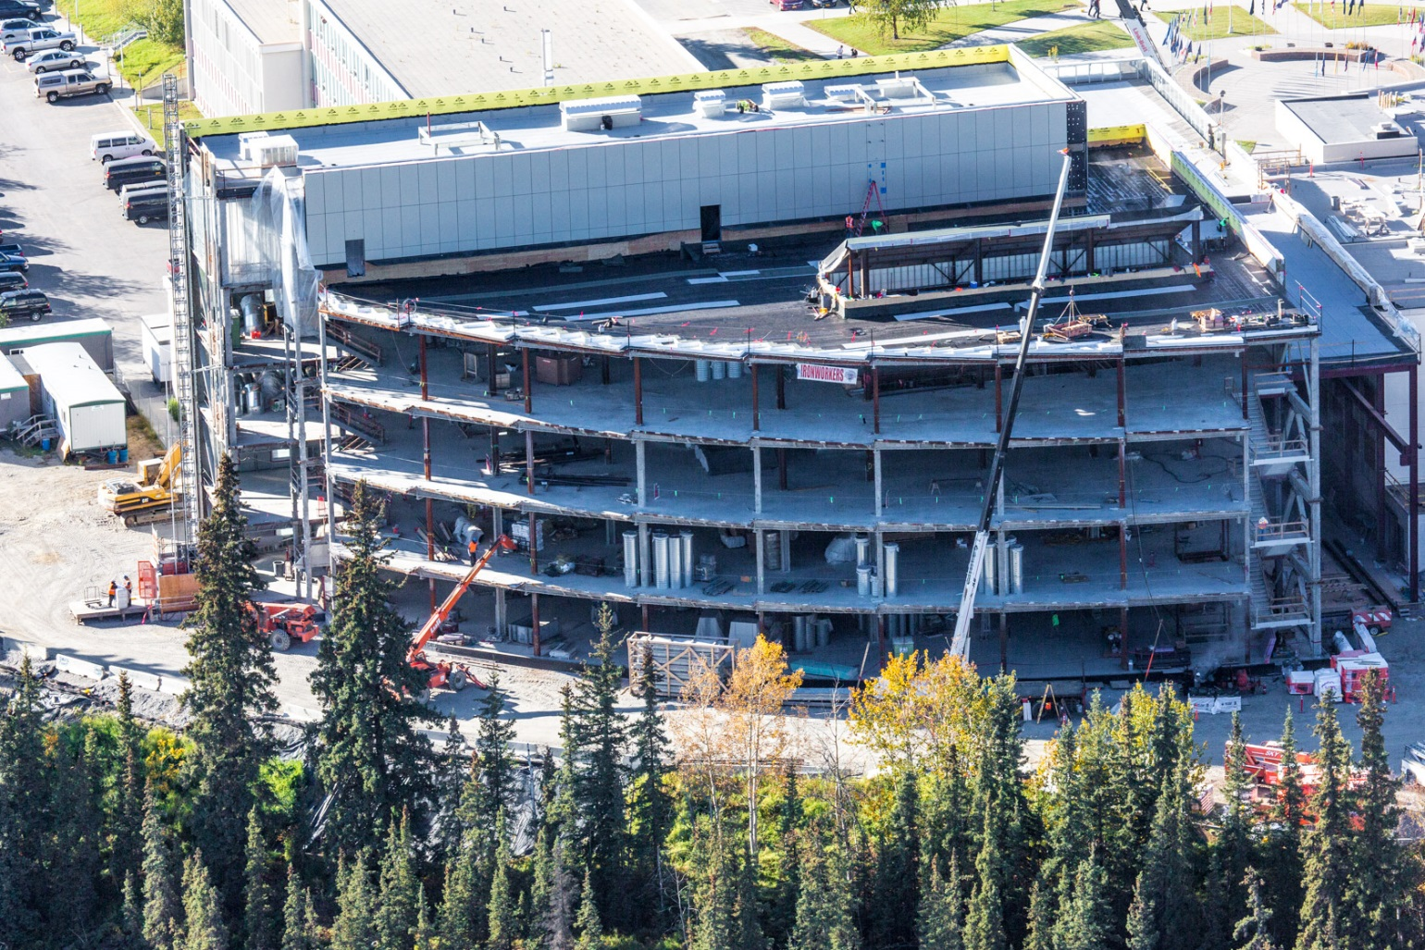
An aerial view of the new UAF engineering building during construction, Fall 2014
Photo courtesy of UAF Photography

Slide 22


Slide 23
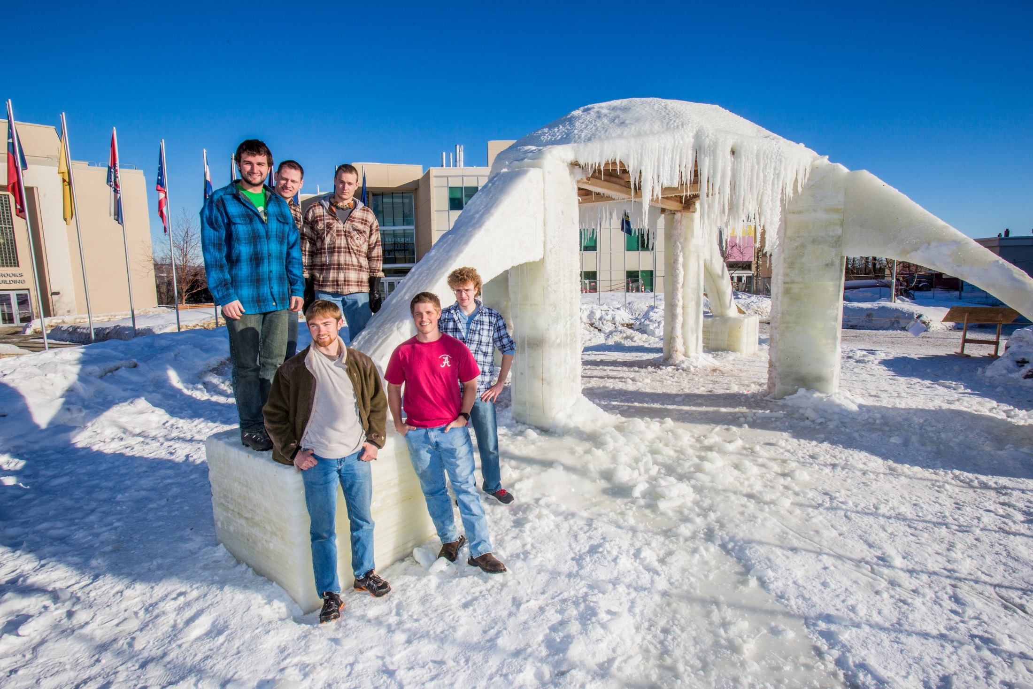
Engineering students admire their work on the 2014 Ice Arch
UAF Photo by Todd Paris

Slide 24
CONGRATULATIONS TO THE NEW 2014/2015 F.E.s!
Eric Carter
Jesse Cervin
Michael Chavez
Richard Chiesa
Clayton Choromanski
Charles Coisman
James Collier III
Denali Critchett
Bradley Cruickshanks
Ronald Cuanzon
Kodiak Cullen
Diego Davila Lourenco de Lima
Christopher Dawkins
Ashley DeVore
Sterling DeWilde
Jay Doubt
Austin Dukowitz
Heather Edic

Slide 25
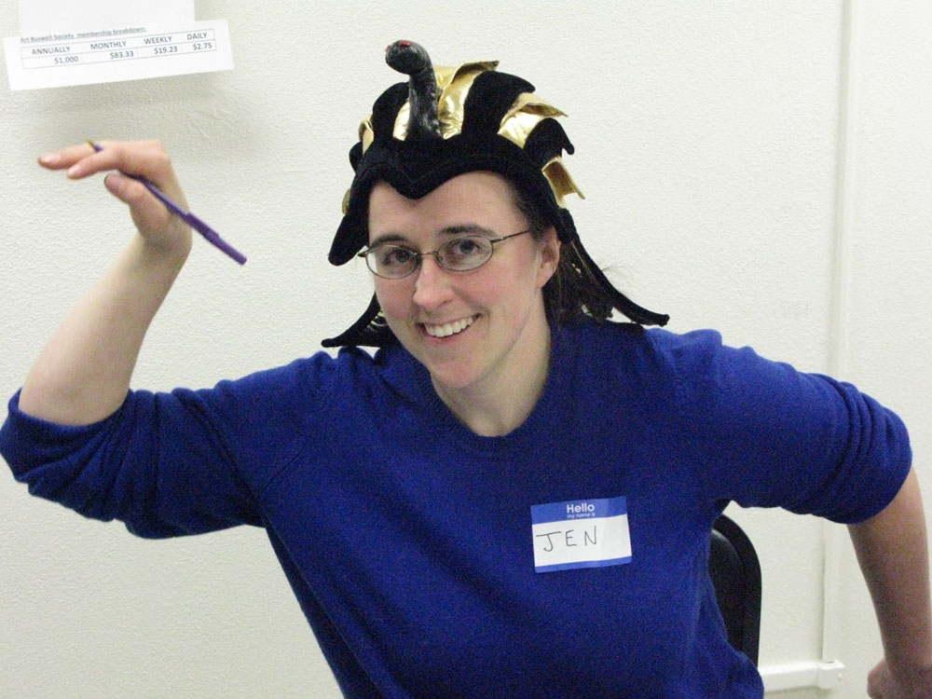


Slide 26
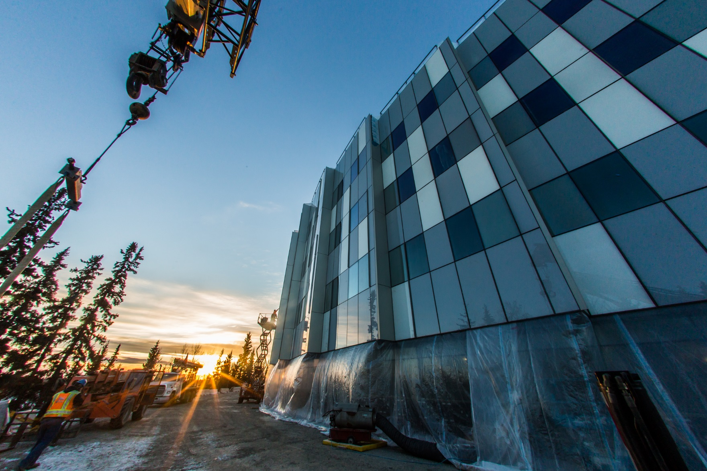
Sunset over the new UAF engineering building
Photo courtesy of UAF Photography

Slide 27
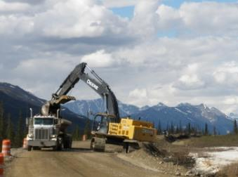
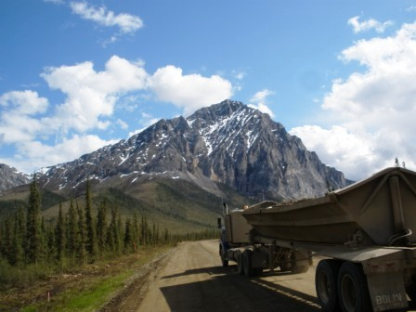

• Road Construction and Repair
• Highway Construction and Repair
• Erosion Control
Contractors

Slide 28
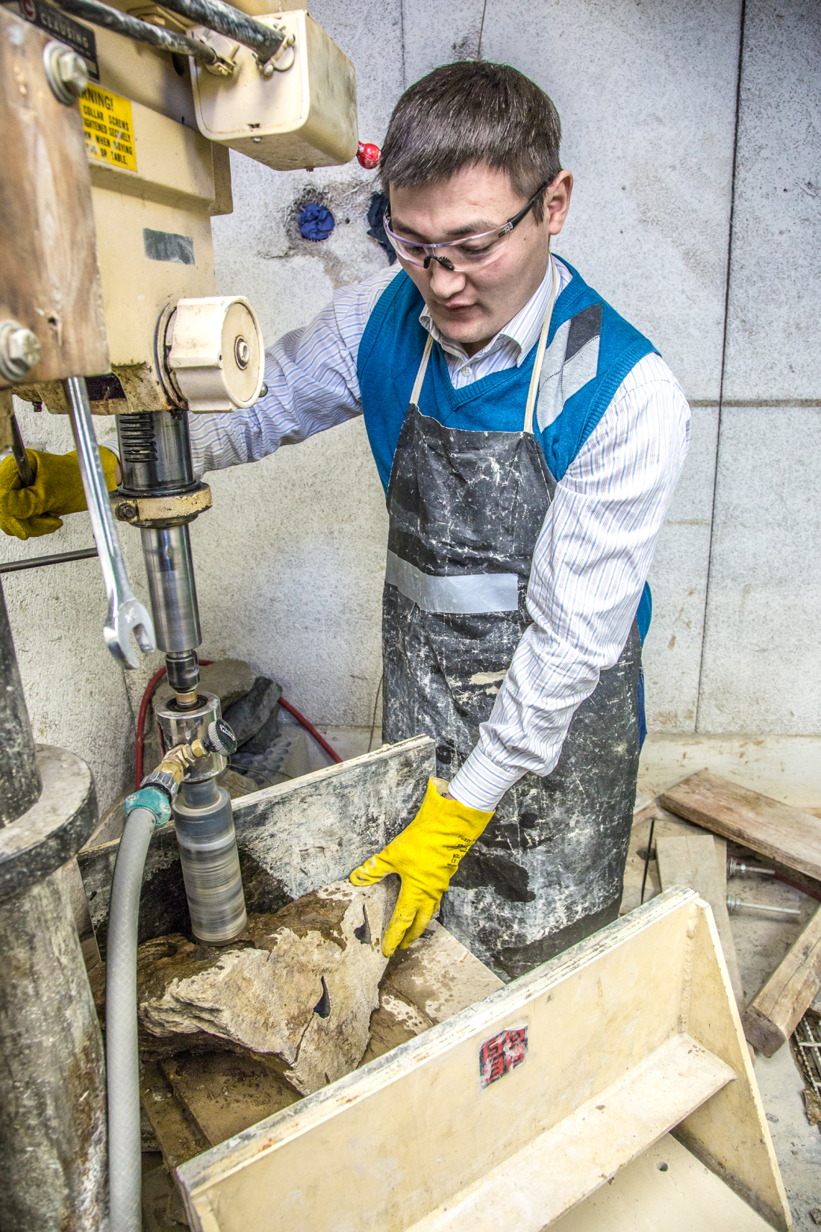
A UAF CEM graduate student works with samples of rare earth minerals
UAF Photo by Todd Paris

Slide 29
Math Counts Challenge!
Molly has eight U.S. coins with a total value of 78 cents. She does not have any half-dollars. How many dimes does Molly have?
Answer to follow

Slide 30
Answer: 2 (dimes)

Slide 31



THANK YOU TO OUR
GENEROUS SPONSORS
Contractors

Slide 32
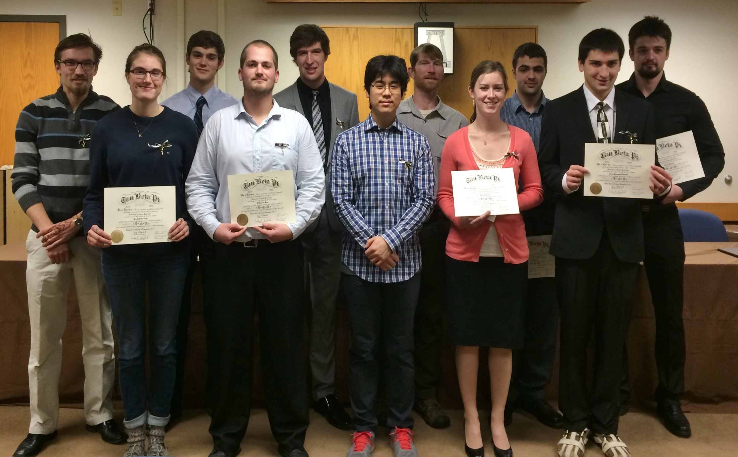
Fall 2014 UAF Tau Beta Pi initiates
Photo courtesy of Margaret Darrow

Slide 33
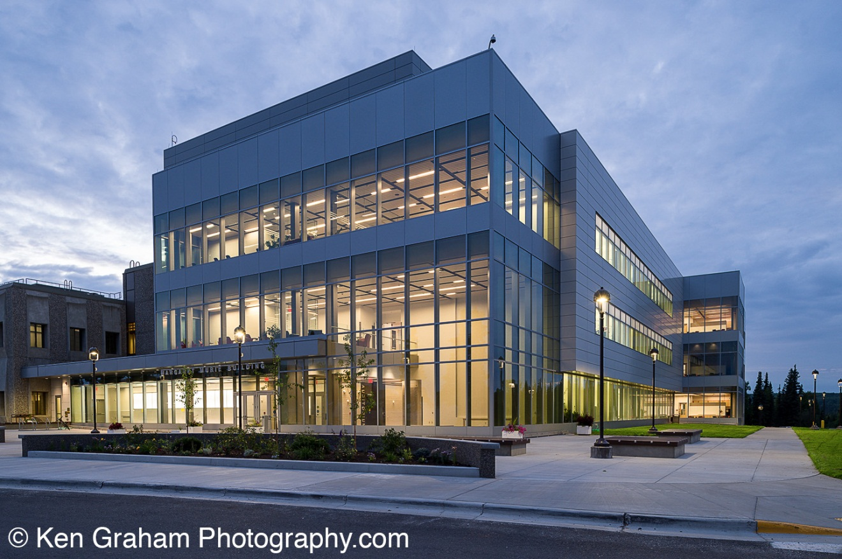
Margaret Murie Building - University of Alaska Fairbanks

Slide 34

Thank You To ConocoPhillips For Their Generous Sponsorship!

Slide 35
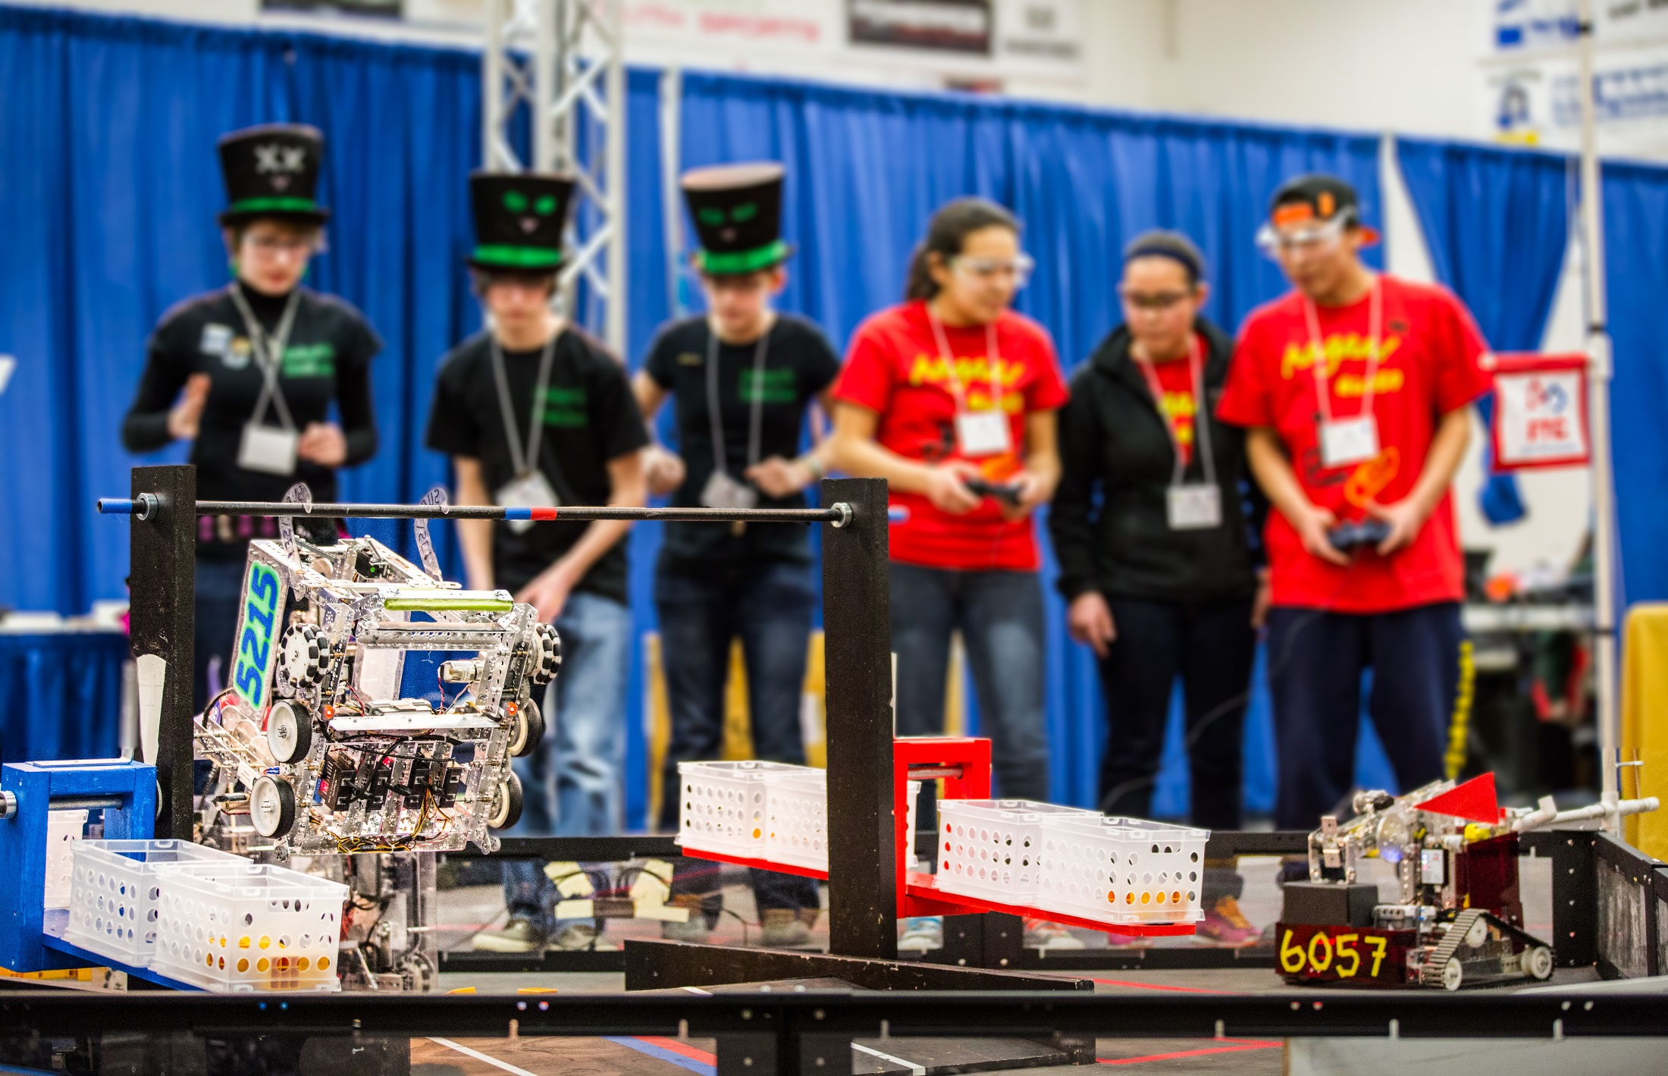
High school students compete in the UAF-sponsored 2014 FTC Robotics State Championships
Photo courtesy of UAF Photography

Slide 36
CONGRATULATIONS TO THE NEW 2014/2015 F.E.s!
Seth Alexander
Jake Alward
Richard Bailey
Jennifer Baker
Logan Balstad
Robert Barnett
Forrest Bauman
Sean Berg
Ryan Bergerson
Adam Bernardi
Alexander Bertram
Jare Boerger
Peter Brewer
Winston Burbank
Wesley Burgess
Brandon Burgett
Blake Burley
Seth Campbell

Slide 37
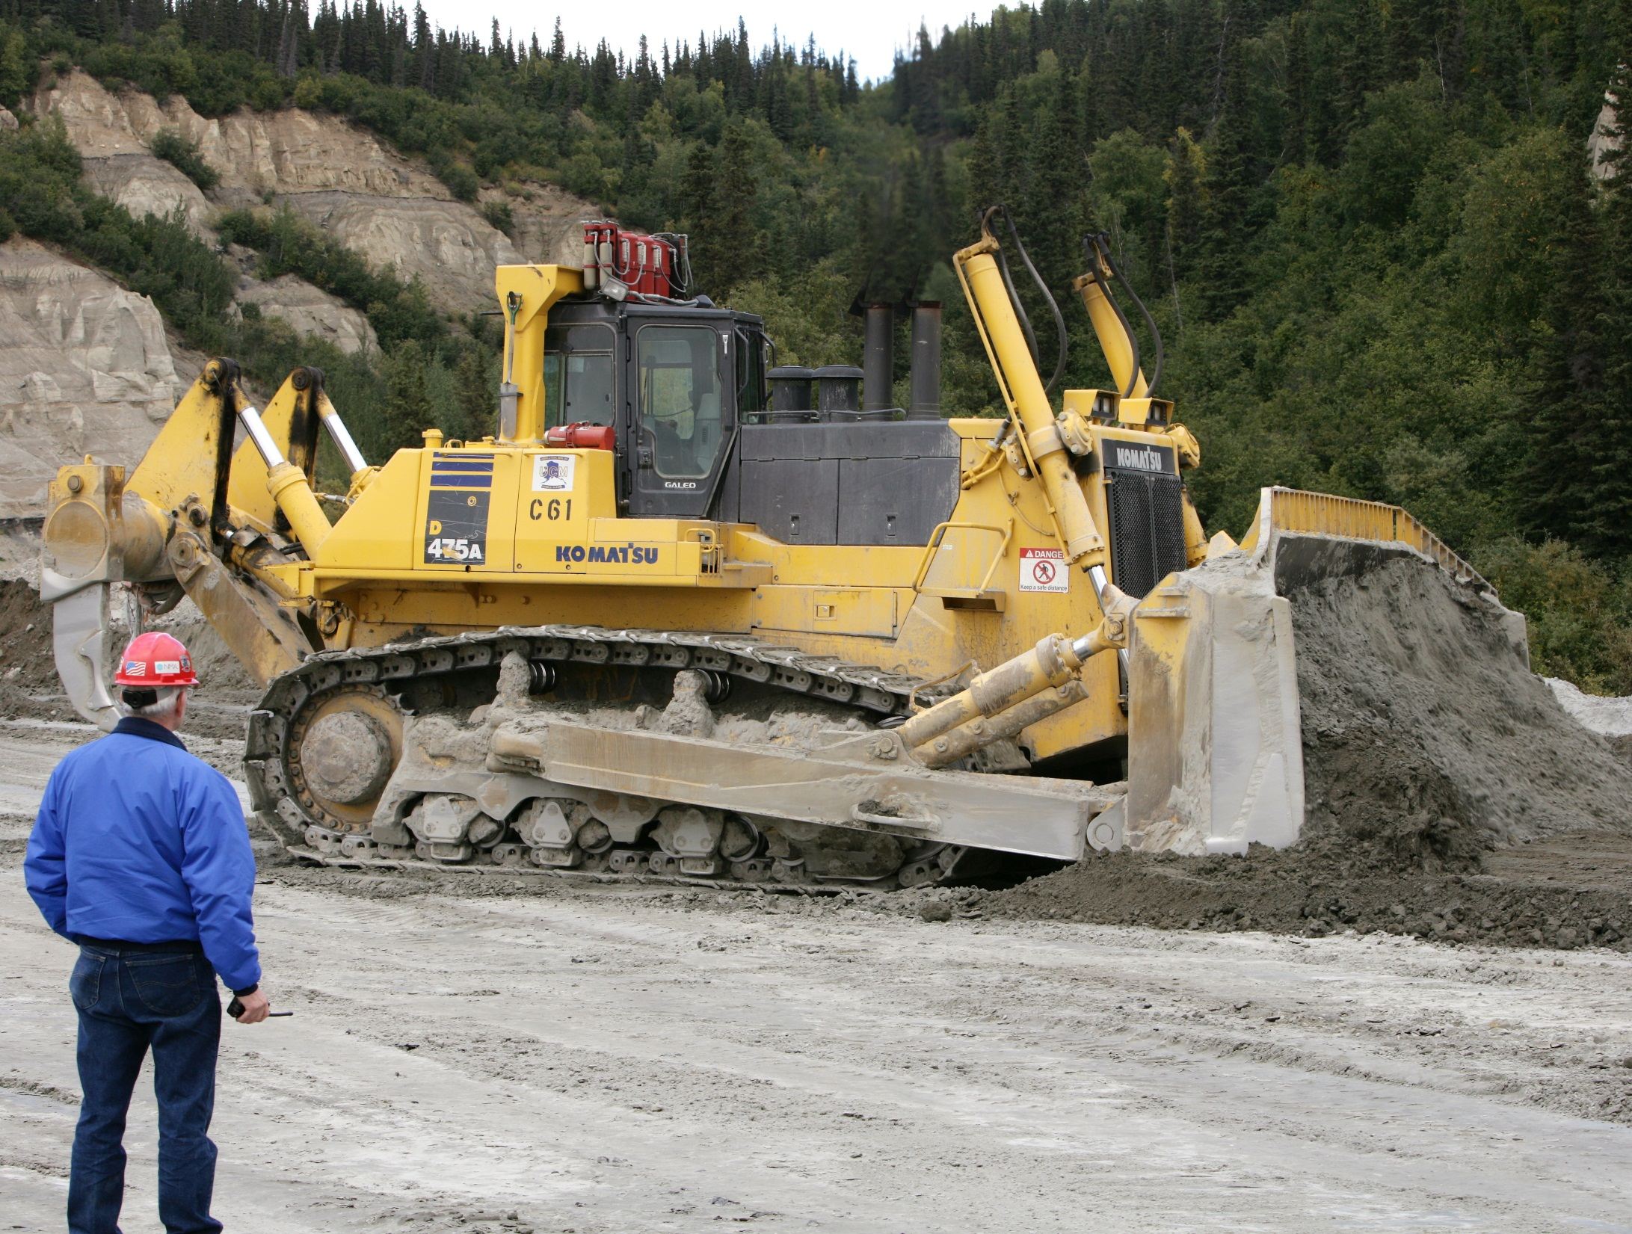

Slide 38
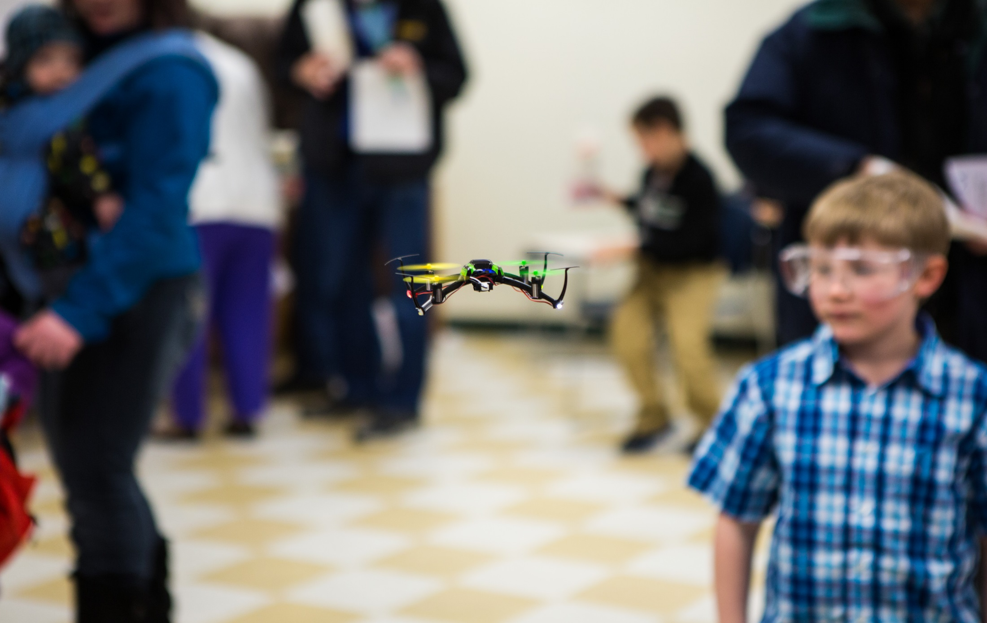
Participants watch a UAV demonstration during the 2014 CEM Engineering Open House event
Photo courtesy of UAF Photography

Slide 39

Dr. Leroy Hulsey test-drives UAF’s first concrete canoe submission at the regional competition at Portland State University
Photo courtesy of UAF Department of Civil and Environmental Engineering

Slide 40
Thank You To Our Sponsors!

Slide 41
Math Counts Challenge!
The cost of daily school lunch increased from $1.80 to $2.25. What was the percent increase?
Answer to follow

Slide 42
Answer: 25 (percent)

Slide 43
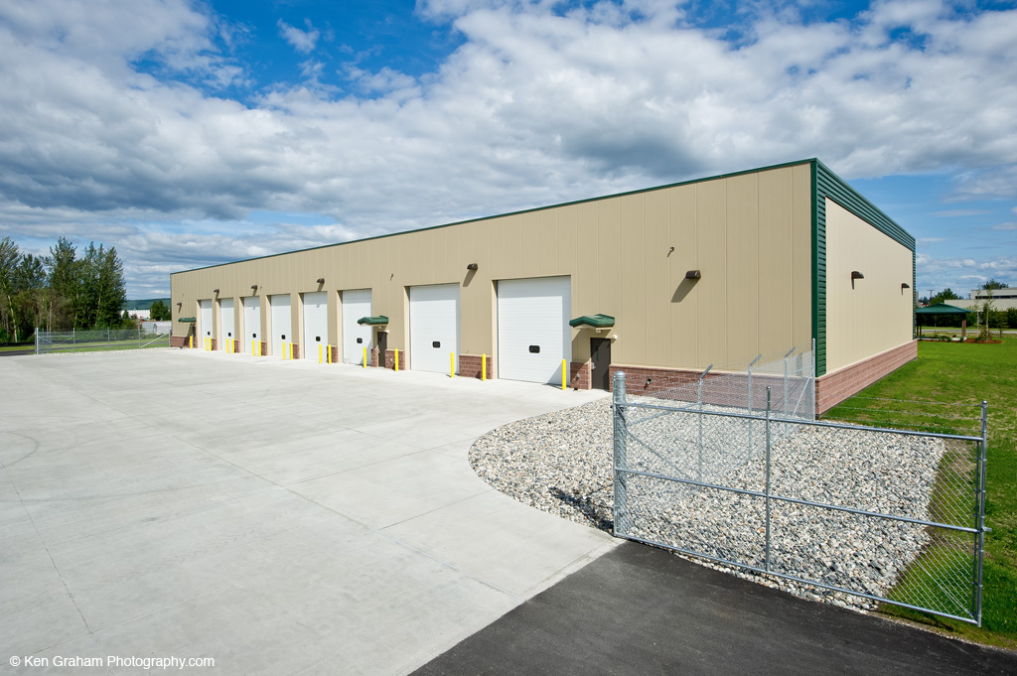

Slide 44
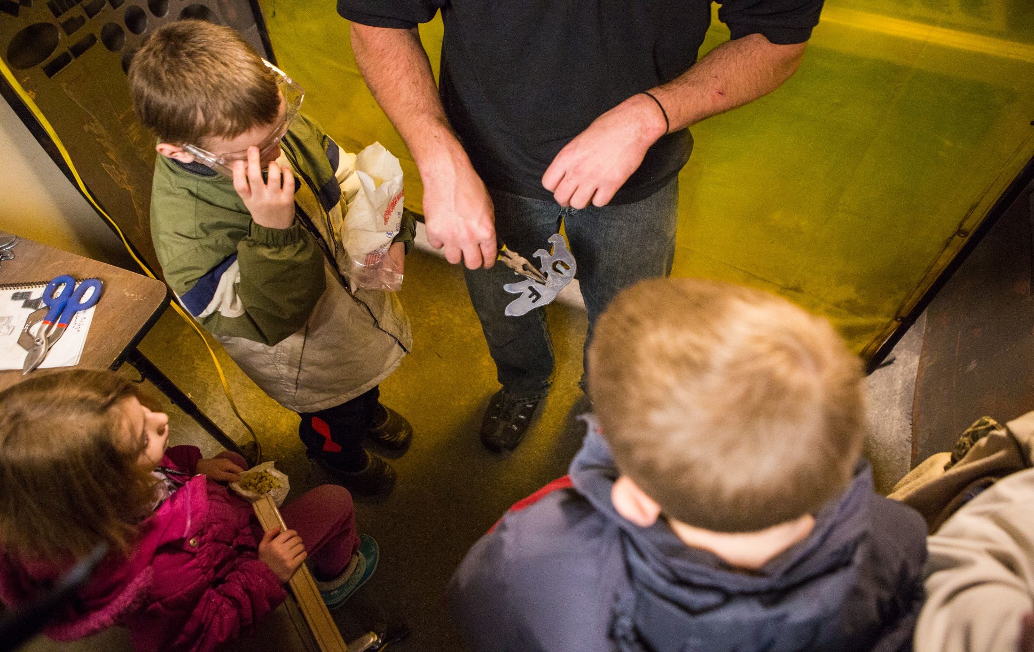
Participants watch a Plasma Cutter demonstration during the 2014 CEM Engineering Open House event
Photo courtesy of UAF Photography

Slide 45
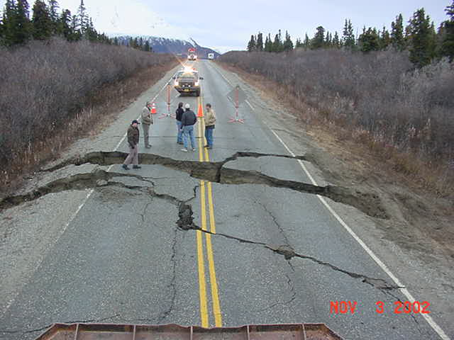


Slide 46
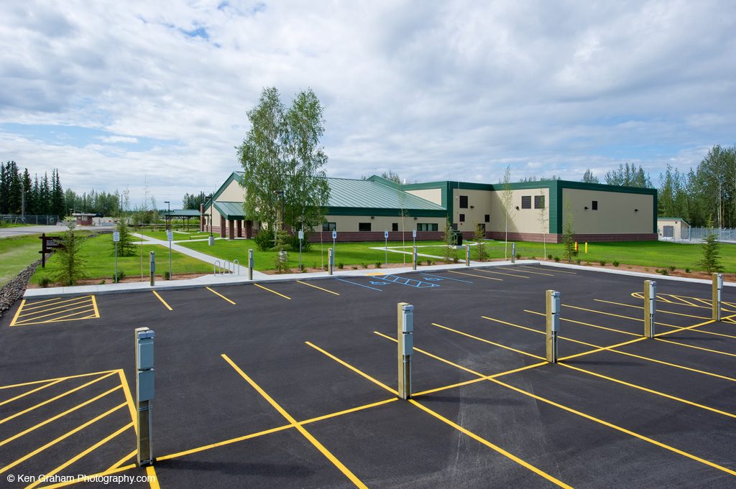

Slide 47


Slide 48
CONGRATULATIONS TO THE NEW 2014/2015 F.E.s!
Dalton Ellingson
Marcus Farquhar
Zachary Garcia
Lance Gatter
Douglas Gelineau
Nathan Goering
Jamie Gorman
Cody Gossel
Robert Goughnour
Logan Graves
Martin Gray
Seth Grove
Paul Harren
Charles Hnilicka III
Sarah Hoffman
Charles Holman
Travis Holmes
Katie Hopkins

Slide 49
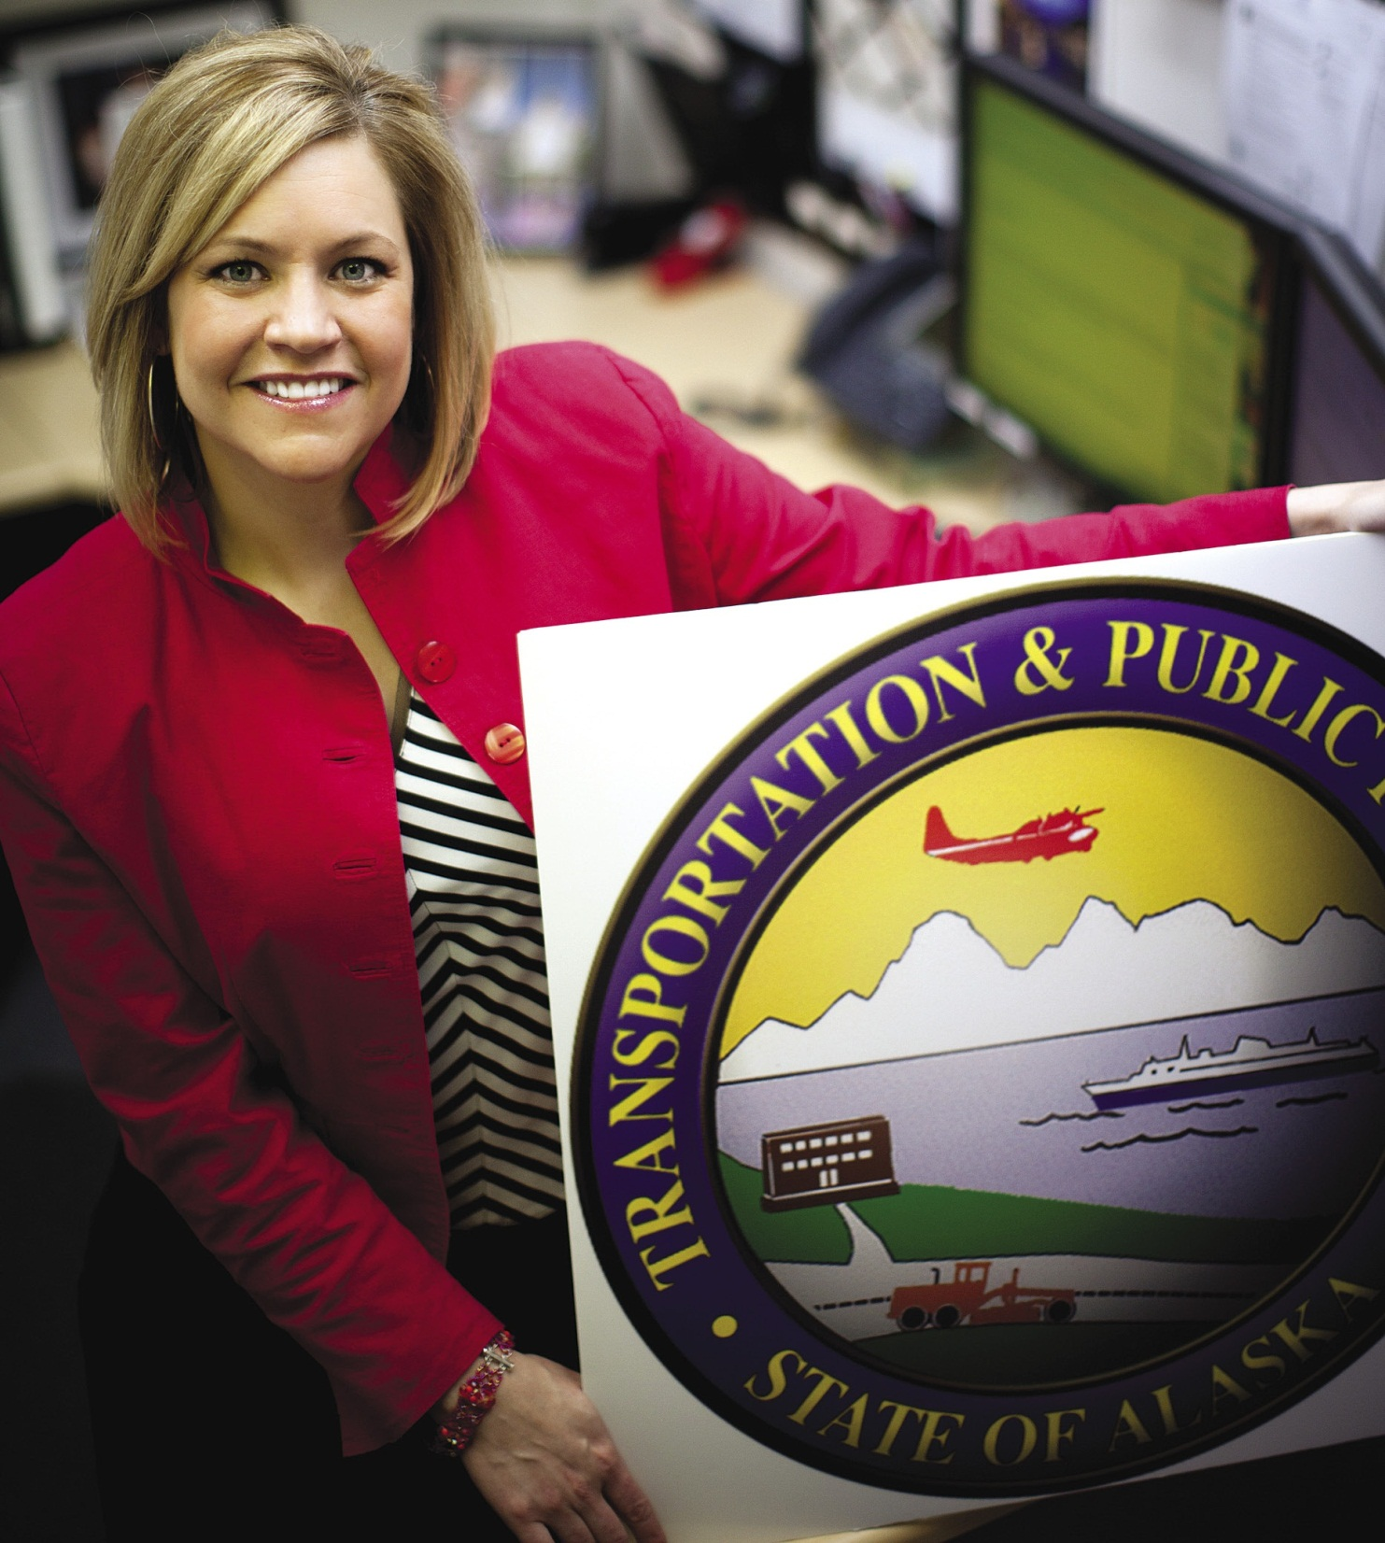

Slide 50
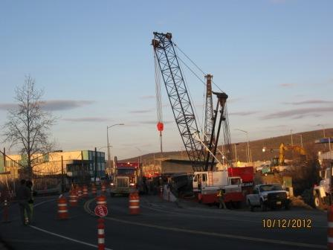
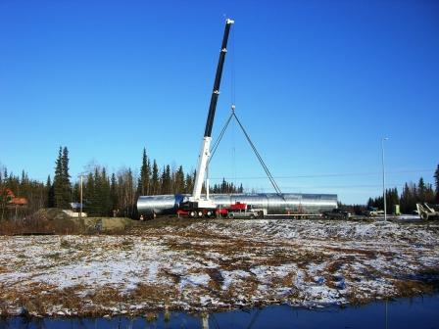
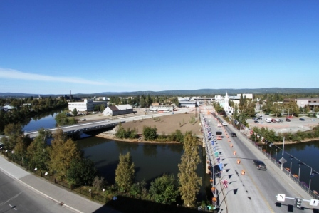
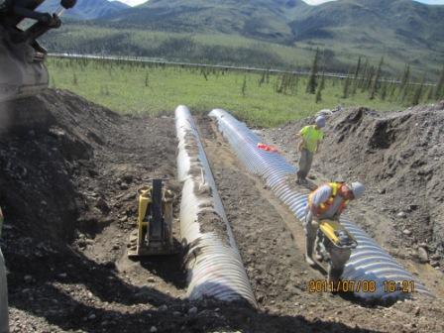
Contractors
• Bridge Foundation
• Utility installation
• Multiplate Installation

Slide 51
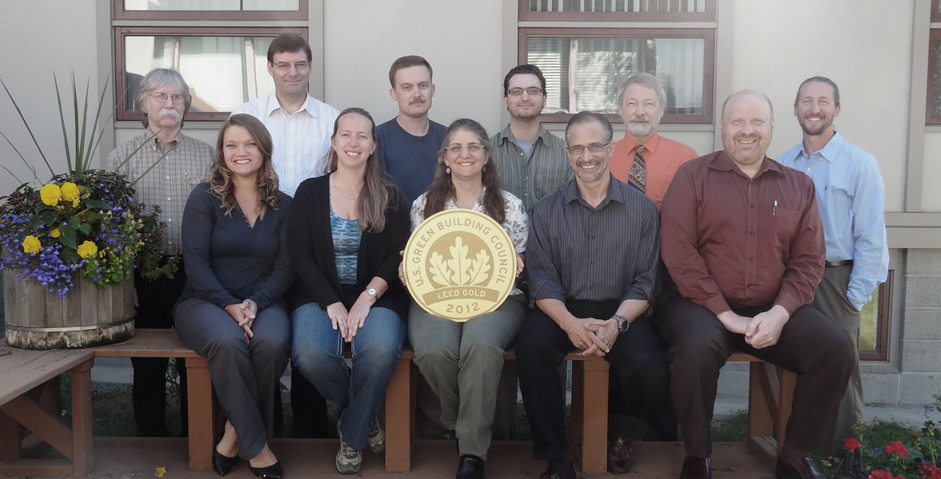

Slide 52
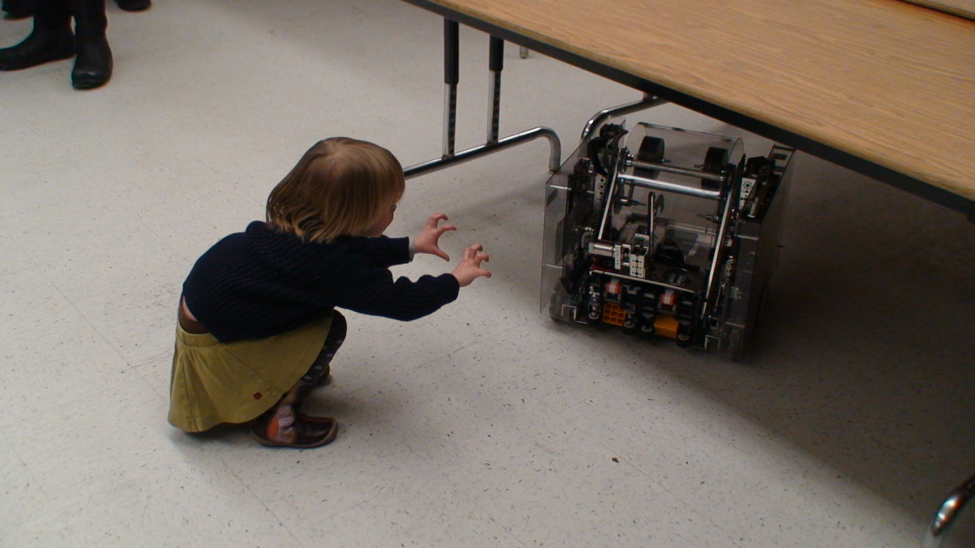
A future engineer practices mind control during a Robotics demonstration at the 2014 CEM Engineering Open House event
Photo courtesy of UAF Photography

Slide 53
Math Counts Challenge!
Richard is thinking of three distinct, positive integers. He tells Barbara their sum is 9, and he tells Lori that their product is 24. What is the median of Richard’s three numbers?
Answer to follow

Slide 54
Answer: 3

Slide 55
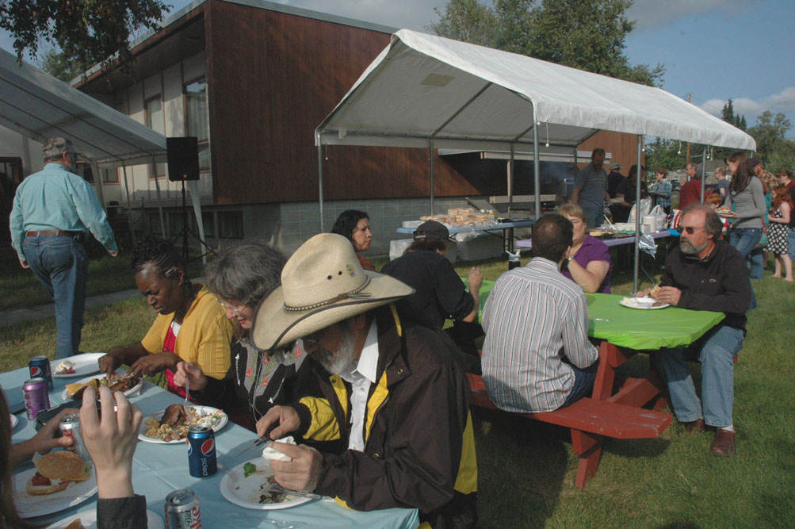

Slide 56


Slide 57
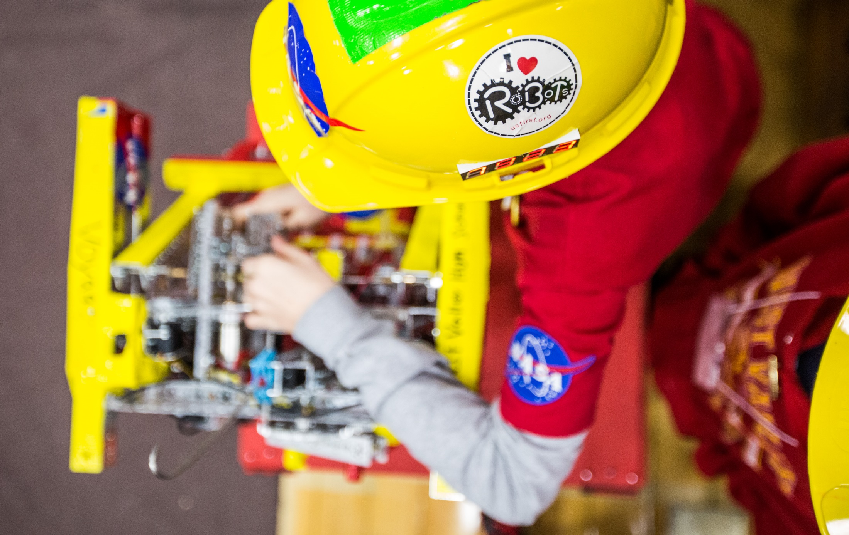
A high school student adjusts his robot during the UAF-sponsored 2014 FTC Robotics State Championships
Photo courtesy of UAF Photography

Slide 58
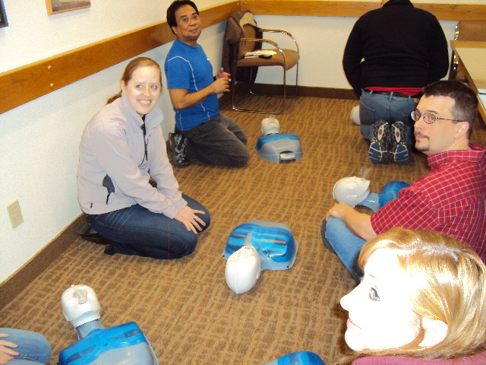

Slide 59


Slide 60
CONGRATULATIONS TO THE NEW 2014/2015 F.E.s!
Garth Hulbert
Austin Hunt
Jared Janssen
Robert Jewett
Morgan Johnson
Shyla Keays
Melinda Kemp
Beaux Kemp
Artem Kozyrenko
Mindona Krzykowski
Matthew Madsen
Michael Magnan
Jordan Martin
Brett Martino
Jeff Martt
Evan Mathers
Ian McKee
Alyson McPhetres

Slide 61


ConocoPhillips is pleased to support EWeek

Slide 62
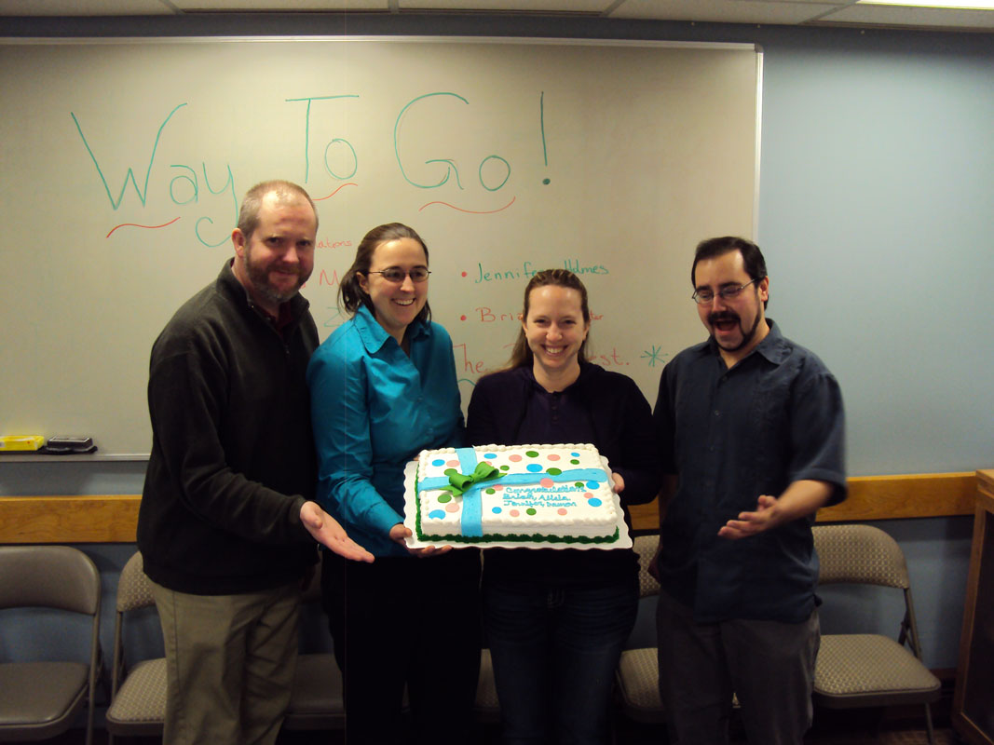

Slide 63
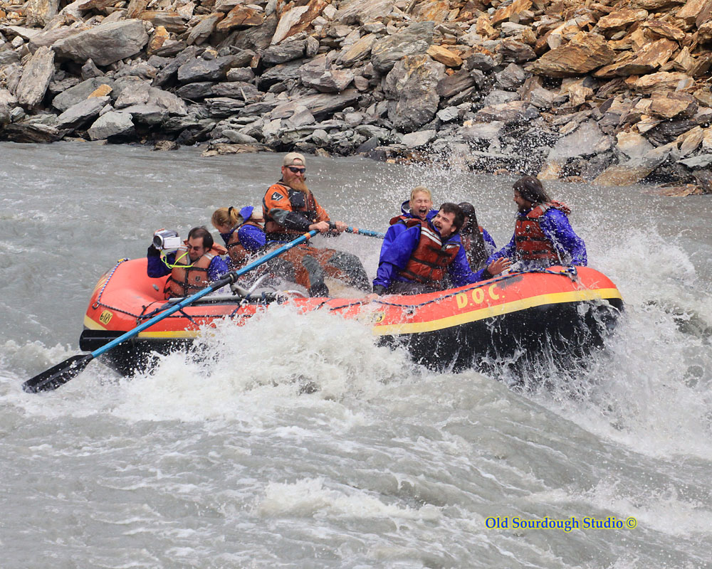

Slide 64
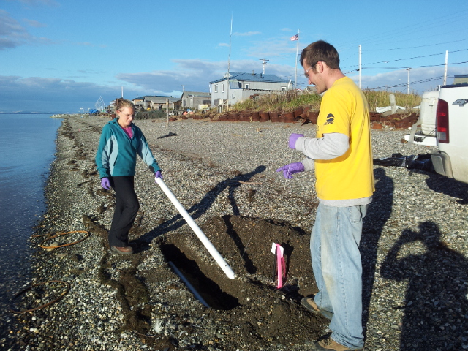

Slide 65
Math Counts Challenge!
Sharon drives 30 mi at 60 mi/h and 60 mi at 30 mi/h. What is Sharon’s average speed, in miles per hour, for the whole trip?
Answer to follow

Slide 66
Answer: 36 (mi/h)

Slide 67
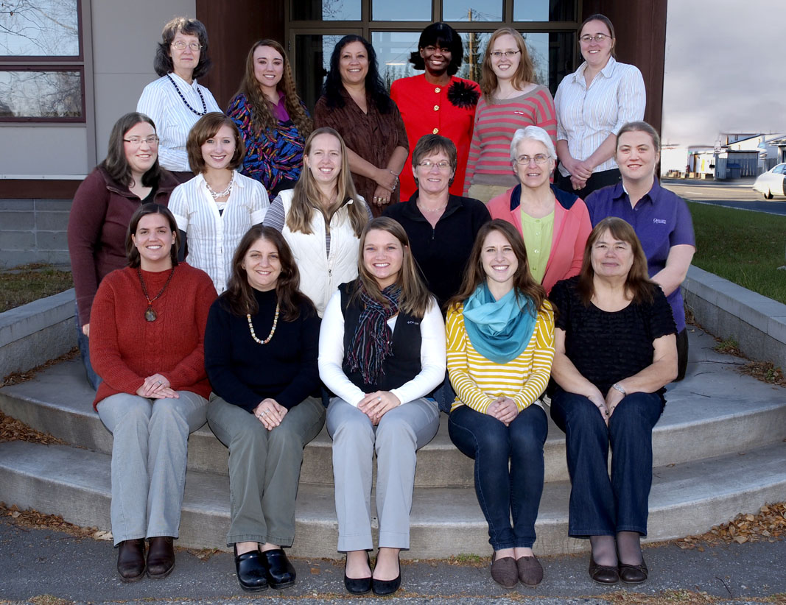

Slide 68
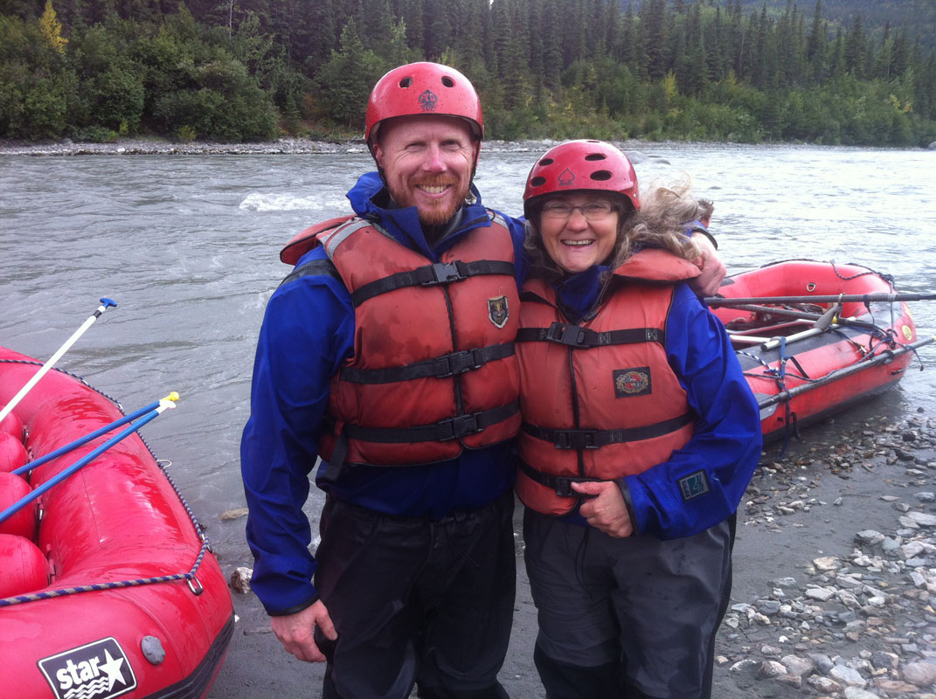

Slide 69
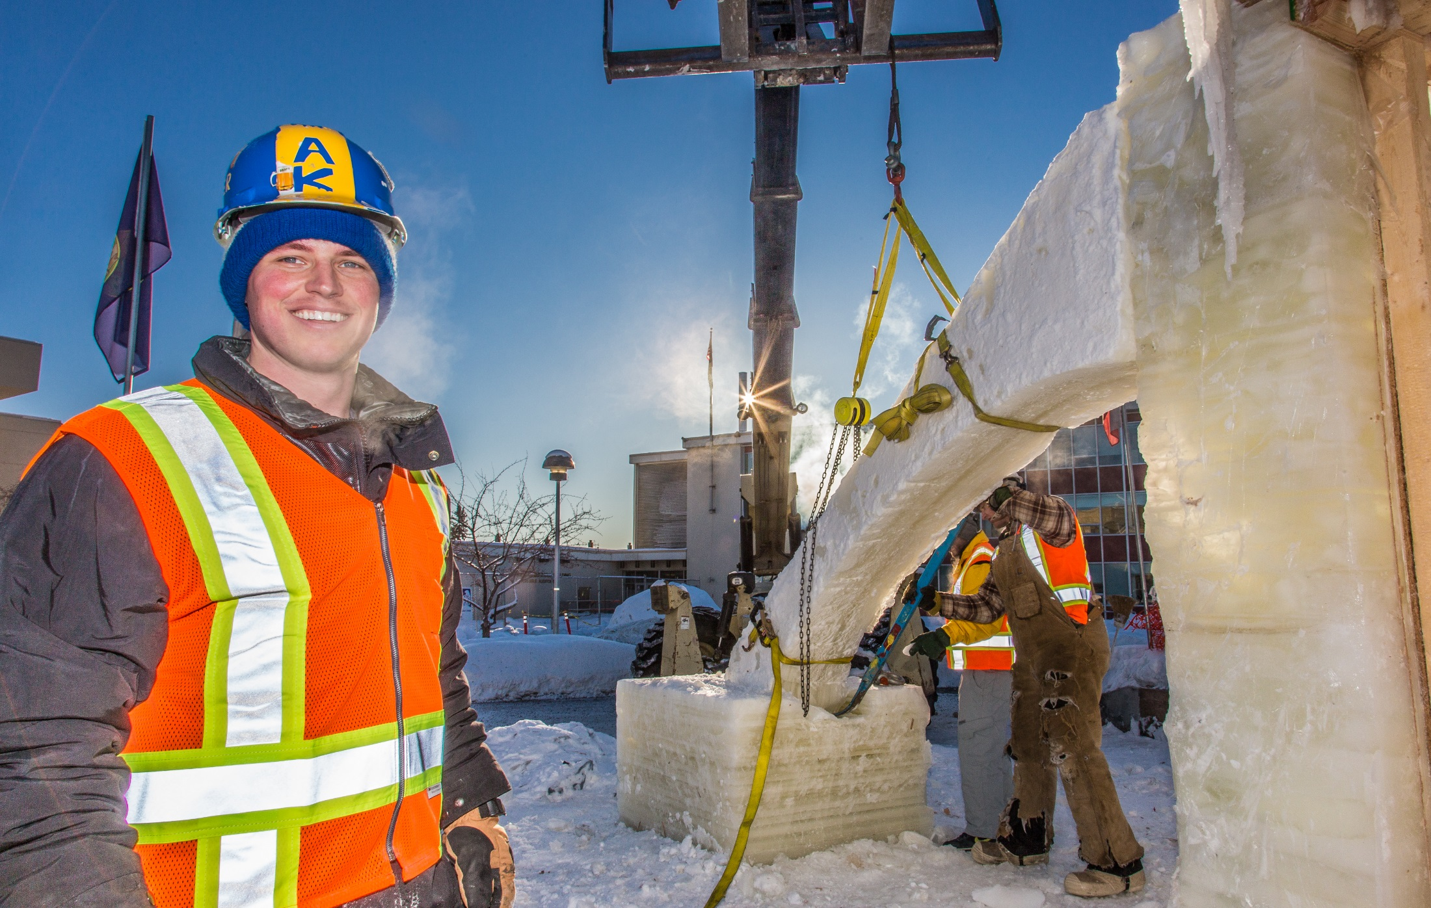
Engineering students and volunteers from GHEMM Company raise the 2014 Ice Arch
UAF Photo by Todd Paris

Slide 70

Arctic Engineering
Geotechnical
Environmental
Natural Resources
Asset Management
Construction Observation and Testing
GIS
Hydrogeology
Instrumentation
Laboratory Testing
Mining Engineering
Seismic
Tunneling

Slide 71
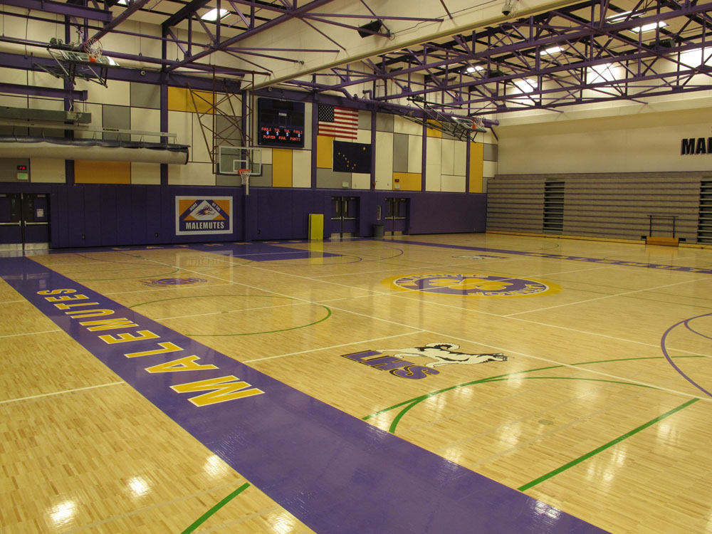

Slide 72
CONGRATULATIONS TO THE NEW 2014/2015 F.E.s!
Mary McRae
Jordan Merkes
Jacob Minturn
Jacob Monagle
David Morse
Jarrod Nelson
Kristine Odom
Nathan Oliver
John Pahkala
Lowell Perry
James Peters
Wilson Platt
Thomas Polasek
Jacob Rahlfs
Daniel Randle
Matthew Ranson
Richard Regacho
Dustin Richmond

Slide 73
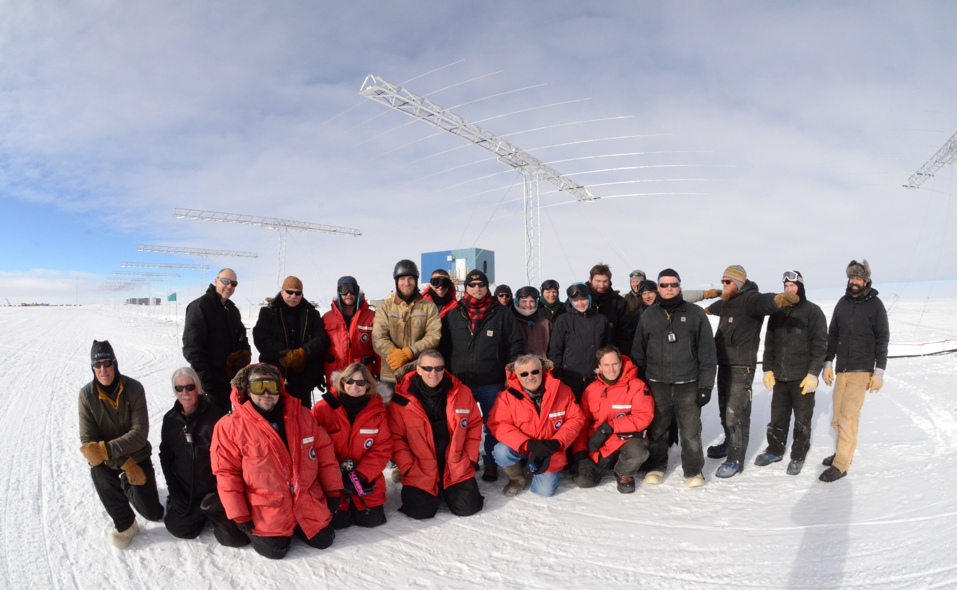
A interdisciplinary team of UAF faculty and students work on an NSF-funded atmospheric radar project in Antarctica
Photo courtesy of UAF Department of Electrical and Computer Engineering

Slide 74
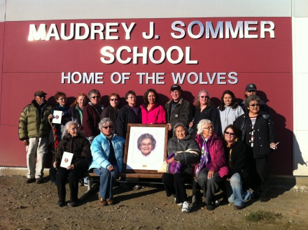

Slide 75
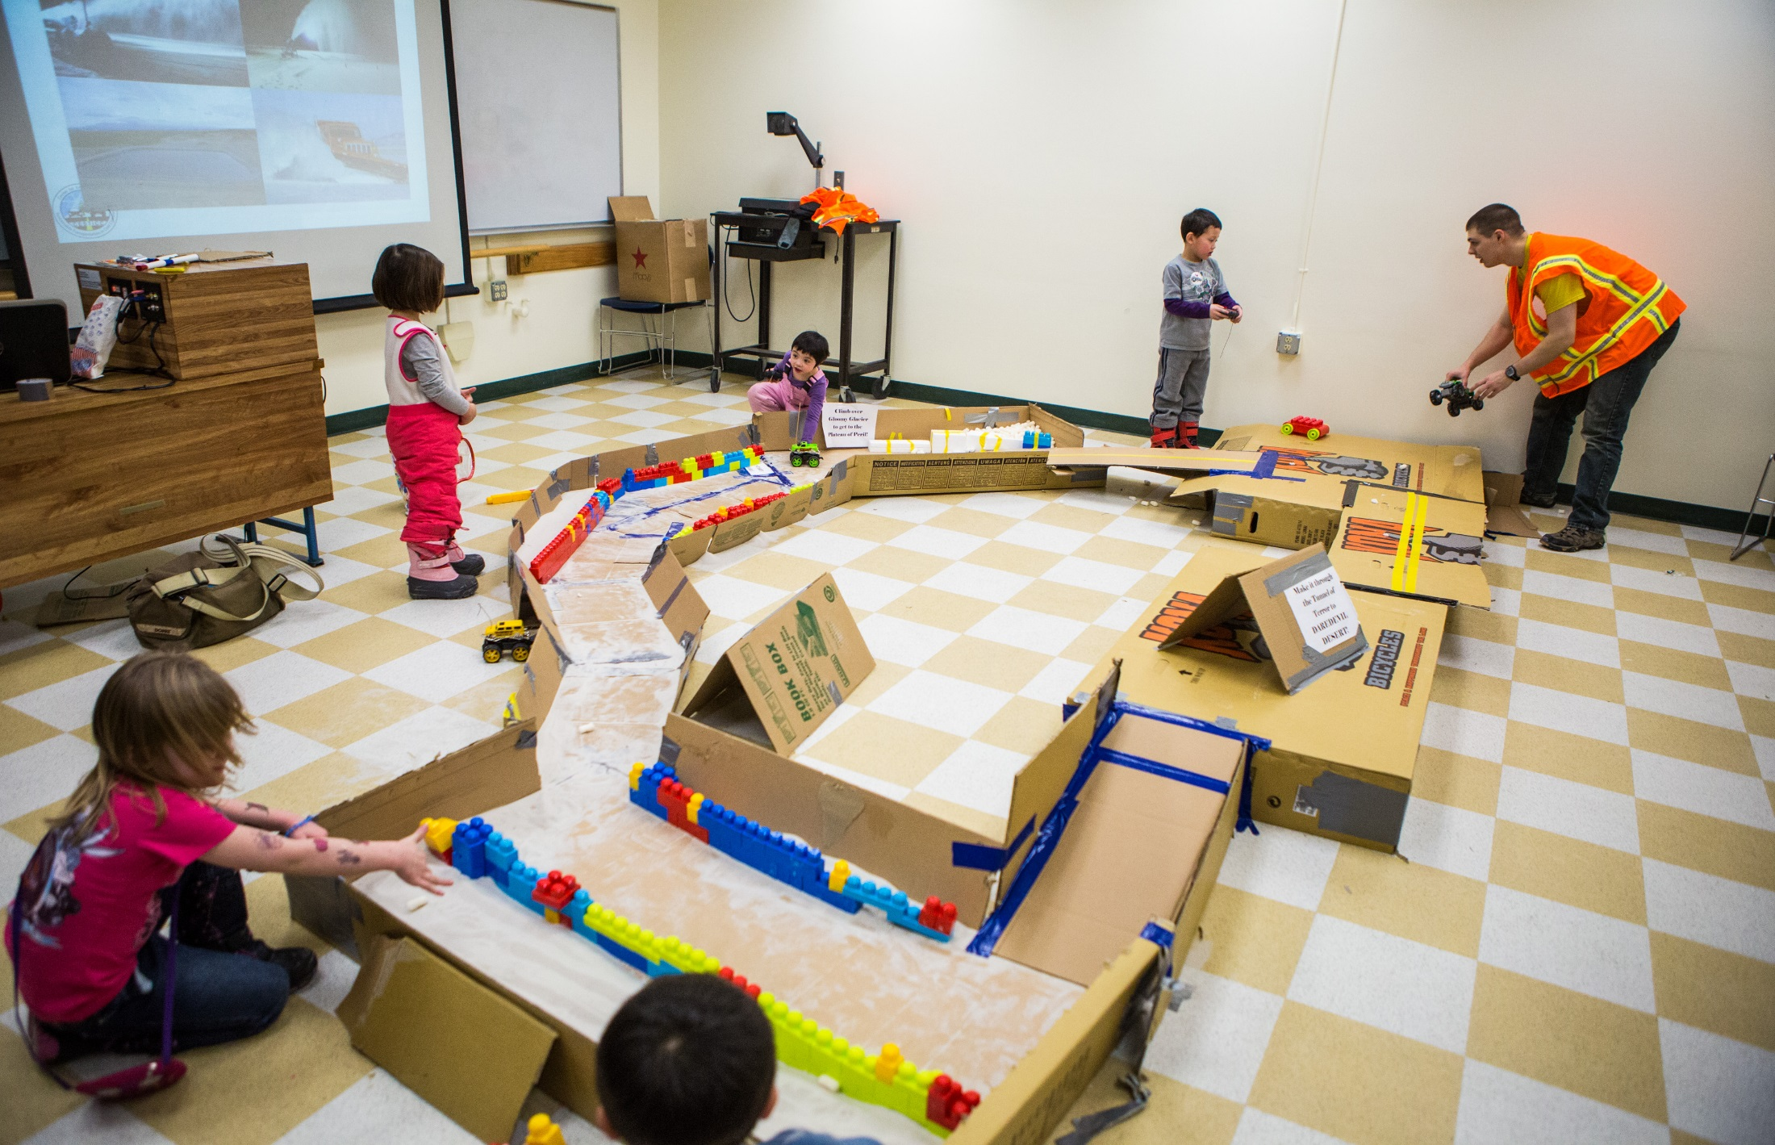
Participants get hands-on experience during a Micro-Mouse demonstration at the 2014 CEM Engineering Open House event
Photo courtesy of UAF Photography

Slide 76
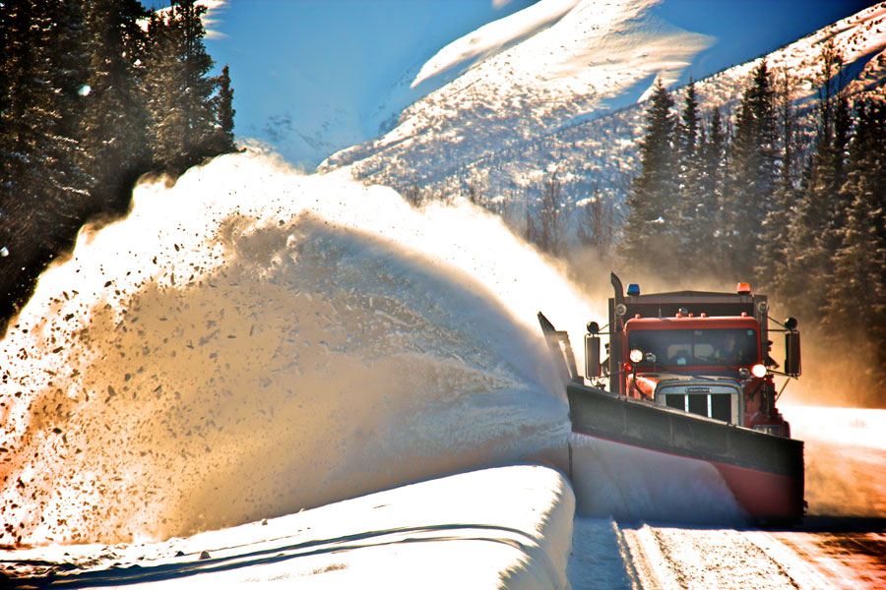

Slide 77
Math Counts Challenge!
In the game Yahtzee®, five standard dice are tossed. What is the probability that all five dice show even numbers or all five show odd numbers? Express your answer as a common fraction.
Answer to follow

Slide 78
1
16
Answer:

Slide 79
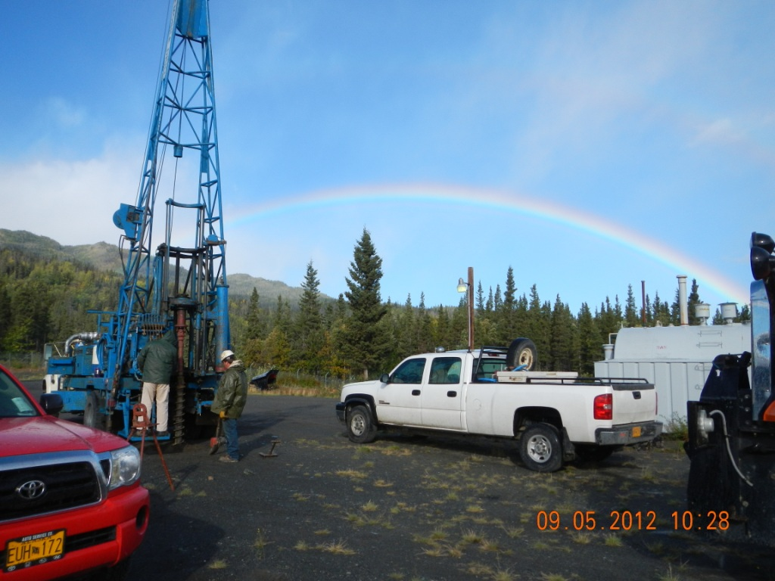

Slide 80


Slide 81

An aerial view of the new UAF engineering building adjoining the existing Duckering Building, Fall 2014
Photo courtesy of UAF Photography

Slide 82



Slide 83


Slide 84
CONGRATULATIONS TO THE NEW 2014/2015 F.E.s!
Thea Ruckhaus
Austin Schroth
James Shrider
Michelle Simon
Kelvin Simonson
Mark Skya
Seth Smith
Tana Smith
Yan Song
Lauren Southerland
Robert Spiller IV
George Stevens
Sebastian Strickland
Bjorn Sveinbjornsson
Karl Swanson
Joshua Tempel
Erika Tobin
Rebekah Tsigonis

Slide 85



SB Electronics Capacitor:
“The Heart of the Motor Controller”
Power Ring Capacitor
Uses Film Technology
600V Rating
1000 uF (microfarad)
Capable of handling 500A ripple

Slide 86


Slide 87

12 Volt System and Headlights
12V system powers motor controller, BMS, dashboard displays, relays, and headlights
Stock headlights replaced with two 10W LEDs
Reduced draw on 12V system by 90%

Slide 88


Slide 89
Math Counts Challenge!
What is the value of 8 ÷ 8 − 8 + 8 × 8?
Answer to follow

Slide 90
Answer: 57

Slide 91


Slide 92

An engineering student enjoys the nice weather in UAF’s concrete canoe submission during the regional competition at Portland State University
Photo courtesy of UAF Department of Civil and Environmental Engineering

Slide 93



Slide 94


Slide 95
CONGRATULATIONS TO THE NEW 2014/2015 F.E.s!
Tsakhiur Tsogtsaikhan
Erin Urvina
Marjorie Valdez
Vincent Valenti
Gerrit Verbeek
Rachel Ward
Richard Ward
Brett Wells
Micah Williams
Ryan Williams-Cudo
Shawn Wooten
Zackery Wright

